Slide 1
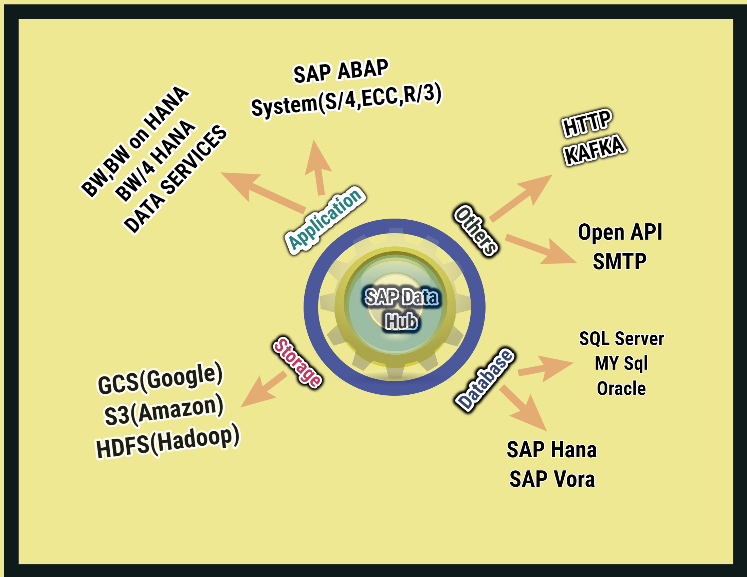
Connection Components for SAP Data Intelligence Use Case
SAP System
S/4,ECC,R/3
BW,BW on HANA
Data Services
Cloud Storage
GCS
S3
HDFS
Database
SAP HANA,VORA
SQL Servr,Oracle
MY SQL
Others
HTTP,KAFKA
Open API,SMTP

Slide 2
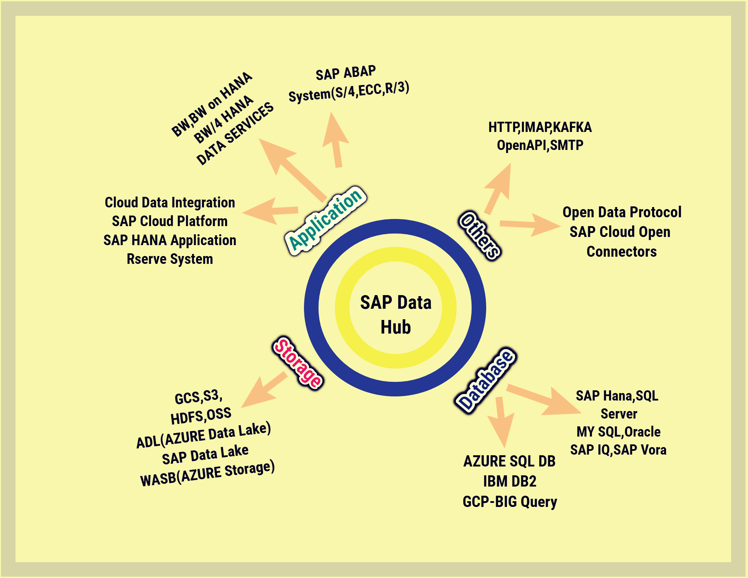
SAP Data Hub All Connection Components

